Slide 1
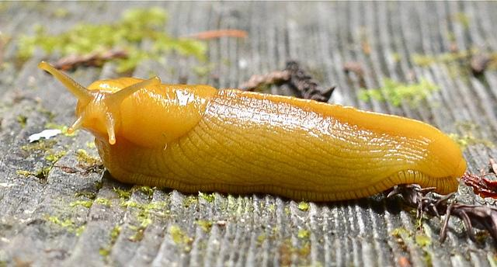
SlugChat
June 1, 2016
Group 4
Chris Kyle: Product Owner
Christopher Ketchum
Marvin Corro
Aramis Marden
Joseph Faulkner
Aramissd

Slide 2
Introduction to the problem
No one website had all the features of eCommons and piazza.
We tried to create a website that had the best features of both websites, with some new features we felt would enhance the user experience.
Notes:
Chris

Slide 3
Recap of Goals
Chat with classmates in real time.
Conveniently access important class files in one place
Ask and view questions pertaining to assignments
Take quizzes and attendance without external hardware
Notes:
CJ

Slide 4
Achieved
File upload/download
Real time chat system
Course creation and enrollment
Distinguish between students, TA, and professors
Lecture note viewer
Online quiz proctoring
Notes:
Aramis

Slide 5
Not Achieved
We were not able to complete the forum aspect of our project, we replaced that portion with comments.
We did not create a way to privately message other users.
Notes:
Aramis

Slide 6
Technologies used
Management Techniques
Django
Python
HTML
CSS
JavaScript
SQLite
Github
Scrum
Slack
Waffle.io
Source Control
Notes:
Marvin

Slide 7
Challenges
Learning Django and Python 3
Resolving git merges and conflicts
Agreeing on which technologies to implement
Employing class/use case stories diagrams
Notes:
Joseph

Slide 8
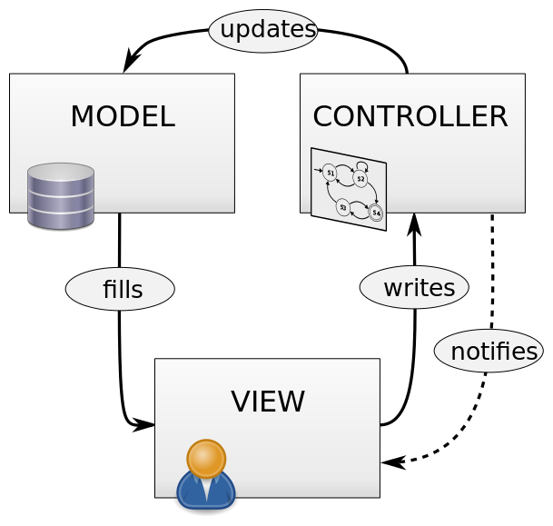
Architecture
Notes:
Chris

Slide 9
Things we...
Enjoyed:
Scrum meetings, helped us understand where every team member was in the project
The project was very hands on approach by the students and hands off by the professor
Didn’t Enjoy:
Fast paced sprints
Notes:
CJ

Slide 10
Lessons Learned
What Worked:
Dividing user stories into many tasks
Using Slack to keep in touch
Collaborating in person
Notes:
Aramis

Slide 11
Lessons Learned
What Didn’t Work:
Waiting to integrate front end with the back end until the end
Burnup chart didn’t seem necessary, we generally knew if we were on track
Notes:
Marvin

